Slide 1
MEMS 2023 Image in Microtechnology Award

Slide 2
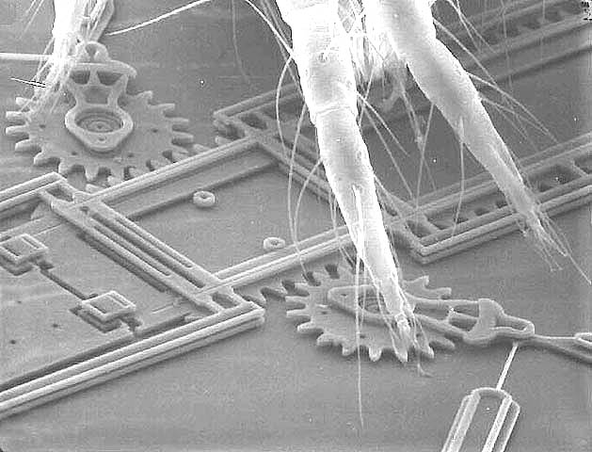
Bugs on MEMS
Example
This was made using a surface micromachining technology featuring four mechanical layers of polysilicon.
Courtesy Sandia National Laboratories, SUMMiT™ Technologies, www.sandia.gov/mstc

Slide 3
Submission

